Slide 1
13/07/2019
HackYourFuture
Databases - Lesson 2
Class 4
Borja Romero Gina Stavropoulou Geert Van Pamel
Lessons 1,2,3 Lessons 1,2 Lessons 2,3

Slide 2

Who is who?
Geert Van Pamel
Belgian, Dutch speaking + EN, FR, DE
Engineer
Worked in the IT industry from 1984-2018
Ran multiple LAMP (Perl, PHP) servers
Volunteer for Wikimedia; active on Wikipedia, Commons, and Wikidata
Also active on OpenStreetMap
Photo: Ronn, CC BY-SA 4.0

Slide 3
Revision (Kahoot!)
Let’s play:
Insert the quiz number shown on the screen
Read the question
You have 20’ to choose one of the answers
Answer the questions faster than the others
Multiple answers can possibly be right
Some answers are tricky (think twice)

Slide 4
First things first
Follow the link, download and source imdb2.sql. (We have updated it for the purpose of this lesson):
https://drive.google.com/open?id=1qgG9lJdrG-_SxSUXUoWkBO-Lvb10cqMh
Source /directory/to/folder/imdb2.sql;
(it will substitute the previous imdb).

Slide 5
Revision (SELECT Text)
The text is always surrounded by quotes.
% represents any combination of characters in any amount (including 0) but only in LIKE conditions.
What happens if you use a % in a where name = ‘%Brussels%’; ?
How do you include a real % in the query?
textPercentage LIKE ‘100\%’ -- \ is what we call a Escape character.
Can’t we use “=” ? What is the difference between:
where name = ‘Brussels’ AND WHERE name LIKE ‘Brussels’
Basically none, although in the IT world you always get surprises:
INSERT INTO t1 VALUES ('davyjones');
SELECT * FROM t1 WHERE c10 = 'davyjones'; -- yields 1 row
SELECT * FROM t1 WHERE c10 LIKE 'davyjones'; -- yields 0 rows

Slide 6

Revision (ORDER BY)
The data order of a SELECT is generally undefined.
Why:
Mathematically in a SET there is no order defined
Technically, based on the optimiser decisions, there can be an order (from the primary key)
If you do a GROUP BY, the output is normally sorted
To choose the sort order, you better use ORDER BY explicitly

Slide 7
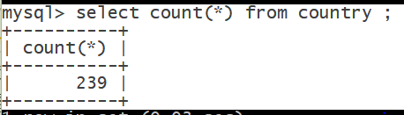
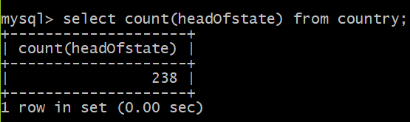
REVISION (COUNTING)
Count(*) FROM Country <- 239
Vs
Count(1) FROM Country <- 239
Vs
Count(headofstate) FROM Country; <- 238 !!! What?
-> Only NON-NULL values are counted!!

Slide 8
Why there is a difference?
select count(*) from country where HeadOfState is null;
1
select case when HeadOfState is null then 'NULL' else 'VALUE' end Data, count(*) Count from country group by Data;
| Data | Count | +-------+-------+ | NULL | 1 | | VALUE | 238 |

Slide 9
REVISION (CREATE)
Create a new database in your system: CREATE DATABASE db_name;
Create a new table:
CREATE TABLE customers
( customer_id INT(5),
FirstName VARCHAR(50) NOT NULL,
LastName VARCHAR(50) NOT NULL,
age INT (3), preferences TEXT,
PRIMARY KEY (customer_id));
Always-> Column Name + Data type, Optional -> Constraints:
The NOT NULL indicates that the inserted value cannot be NULL.
The DEFAULT value is used to specify the default value of the column.
The PRIMARY KEY specifies that values are the unique identifiers.

Slide 10
REVISION (INSERT)
INSERT INTO STUDENT VALUES (1, ‘Rob’, ‘Smith’, 54, ‘Course A’);
But also:
INSERT INTO STUDENT (Id, FirstName, LastName, Age, CourseTitle)
VALUES (1, ‘Rob’ , ‘Smith’, 54, ‘Course A’);
Or
INSERT INTO STUDENT (Id, FirstName, LastName, Age) -- No course title => NULL value
VALUES (1, ‘Rob’ , ‘Smith’, 54);
What do you think that will happen to the Course Title?

Slide 11

REVISION (INSERT)
But even more:
Imagine you need to copy all cities from Europe to a new table.
INSERT INTO EuropeanCities (name, population, region)
SELECT name, population, region FROM city WHERE region LIKE ‘%Europe%’;
This above is combining the INSERT with the SELECT.
You could even have created the table:
CREATE TABLE EuropeanCities
SELECT name, population, region FROM city WHERE region LIKE ‘%Europe%’;

Slide 12
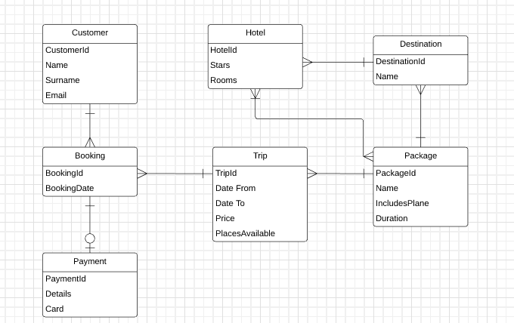
REVISION (ERD)

Slide 13
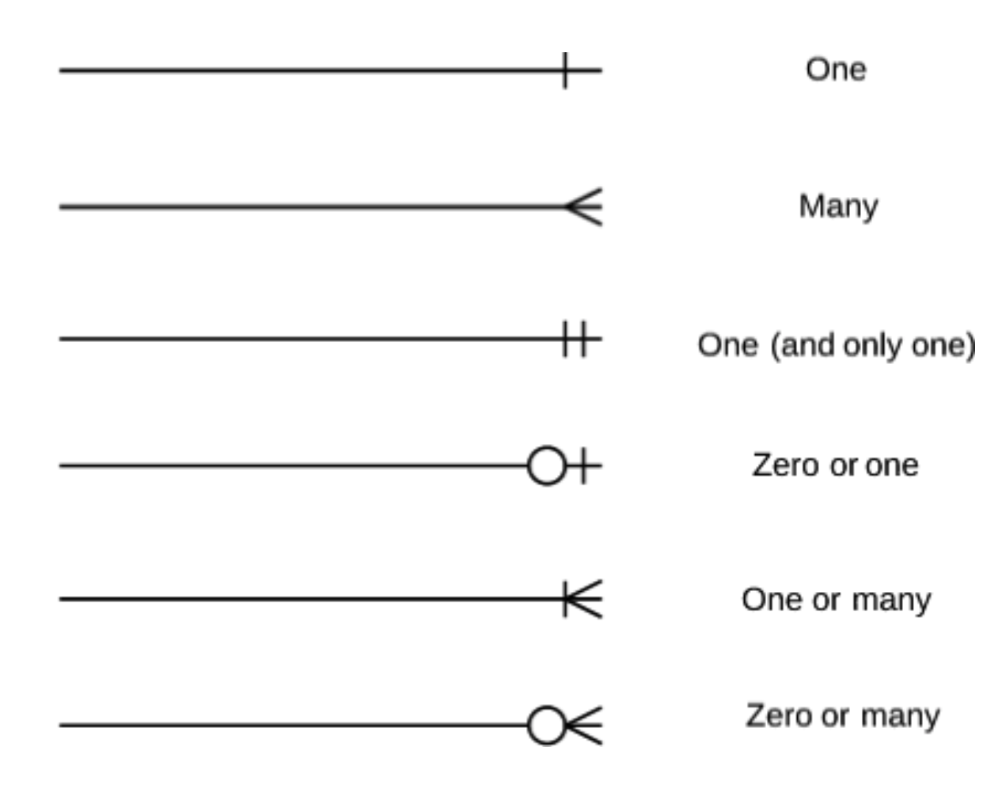
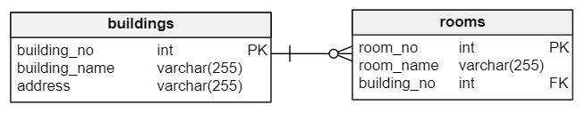
Cardinality & Modality
Cardinality : the type of relationship between rows of tables. 3 cases: One-to-one, one-to-many, many-to-many
Modality: if the relationship between the entities is mandatory (NOT NULL, “1”) or not (NULL, “0”).
Notes:
The relationship type between a row of a table and a row or multiple rows of another table
Modality describes whether a relationship between two or more entities is even required or not

Slide 14
Cardinality & Modality
What is the relationship between the following entities?
Ticker Holder
Seat
https://www.lucidchart.com
User
Credit card
Author
Book
Student
Course
Notes:
One-to-one, ticket holder has one and only one seat, a seat belongs to one and only one ticket holder.
One-to-many, 1-0 can be null, : A user can have from 0 to many cards but a credit card can belong to one and only one holder
One-to-many, 1-1 not null: An author can have from 1 to many books (but needs at least one to be an author)
Many-to-Many 1 student can follow 1 to many courses, one course can be followed from 1 to many students.

Slide 15

DISTINCT
What are the names of the actresses that we have in the database?
SELECT fname FROM actors WHERE gender = 'f';
+----------+
| fname |
+----------+
| Jennifer |
| Anne |
| Meryl |
| Jennifer |
| Helena |
+----------+
5 rows in set (0.00 sec)

Slide 16
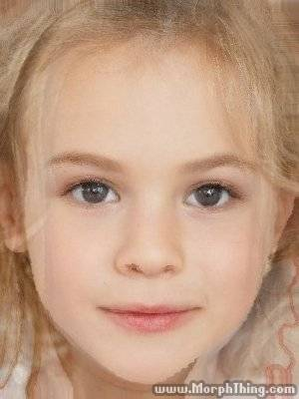
DISTINCT (2)
Great but I just wanted to see the names, I have seen 2 Jennifers, any way to have only the set of different names without duplicates? Let’s try!
mysql> SELECT DISTINCT fname FROM actors WHERE gender ='f';
+----------+
| fname |
+----------+
| Jennifer |
| Anne |
| Meryl |
| Helena |
+----------+
4 rows in set (0.00 sec)
(morph created between Jennifer Lawrence and Jennifer Anniston @ www.morphThing.com)
Notes:
The image is a Morph baby between Jennifer Anniston and Jennifer Lawrence

Slide 17
DISTINCT (Exercise time!)
Two easy ones:
Connect to imdb (the new one).
Make a list with all the directors.
Connect to world.
Make a list of all the regions where there is a country that starts with ‘Q’.
SELECT DISTINCT director
FROM films;
SELECT DISTINCT region FROM country WHERE name LIKE "Q%";

Slide 18
DISTINCT (Exercise time!)
A difficult one:
Connect to the world database
Use the countryLanguage table.
Tell us the languages that are official in a country but they have a percentage of 0%. O_o
SELECT DISTINCT language
FROM countryLanguage
WHERE isOfficial = 'T' AND percentage = 0;

Slide 19
STRING functions
Try the following:
SELECT fname, lname FROM actors WHERE gender ='f';
SELECT CONCAT ( fname, ' ', lname) FROM actors WHERE gender ='f';
SELECT CONCAT ( fname, ' ', UPPER (lname))
FROM actors WHERE gender ='f';
SELECT CONCAT ( substring(fname,1,1), '. ', UPPER (lname)) FROM actors WHERE gender ='f';

Slide 20
Revision ( SELECT FUNCTIONS)
COUNT, MAX, MIN, (SUM & AVG).
Use world.sql
How many countries belong to the region “Northern Africa”?
How many countries belong to the region “Southeast Asia”?
What is the population of the most populated city in Spain?
What is the population of the most populated city in Belgium?
Do the same for the least populated (in China or Japan)
Notes:
This is to go to Group by.

Slide 21
Revision ( SELECT FUNCTIONS)
COUNT, MAX, MIN.
Use world.sql
How many countries belong to the region “Northern Africa”?
SELECT COUNT(*) FROM country WHERE region = "Northern Africa";
How many countries belong to the region “Southeast Asia”?
SELECT COUNT(*) FROM country WHERE region = "Southeast Asia";
Notes:
This is to go to Group by.

Slide 22
Revision ( SELECT FUNCTIONS)
What is the population of the most populated city in Spain?
select MAX(population) FROM city WHERE countrycode = "ESP";
What is the population of the most populated city in Belgium?
SELECT MAX(population) FROM city WHERE countrycode = "BEL";
Do the same for the least populated (in China or Japan):
SELECT MIN(population) FROM city WHERE countrycode = "JPN";
Notes:
SELECT name, population FROM city WHERE population = (select MAX(population) FROM city WHERE countrycode = "BEL");
SELECT name, population FROM city WHERE population = (select MIN(population) FROM city WHERE countrycode = "JPN");

Slide 23

GROUP BY
Pleaaaase, stop asking for regions! But what if …
SELECT COUNT(*), region
FROM country
GROUP BY region;
SELECT MAX(population), countryCode
FROM city
GROUP BY countryCode;
…. gave the same results without asking many times.

Slide 24
GROUP BY (Exercise time!)
Now you!
Connect/use to the imdb database
Find how many actors and actresses are older than 60 grouped by their gender.
Find what is the maximum age for actors and actresses with only one query.
Connect/use the world database
Find in the country table, what is the highest life expectancy per region in regions containing the string Europe (‘%Europe%’)

Slide 25
GROUP BY (Exercise time!)
Find how many actors and actresses are older than 60 grouped by their gender.
SELECT gender, COUNT(*) FROM actors WHERE age>60 GROUP BY gender;
Find what is the maximum age for actors and actresses with only one query.
SELECT gender, MAX(age) AS max_age FROM actors GROUP BY gender;
Find in the country table, what is the highest life expectancy per region in regions containing the string Europe (‘%Europe%’)
SELECT region, MAX(LifeExpectancy) AS max_LIFEEXP FROM country GROUP BY region HAVING region LIKE '%Europe%';

Slide 26
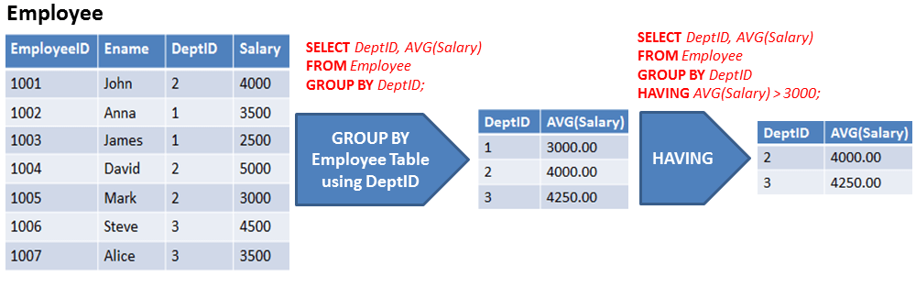
HAVING
A way to filter the aggregated (grouped) results (not the rows)

Slide 27
HAVING (is not WHERE)
List the country codes of the countries having at least 10 cities with 1 million inhabitants:
SELECT countrycode, COUNT(*) AS cityCount FROM city WHERE population >= 1000000 GROUP BY countrycode HAVING cityCount >= 10;
HAVING is applied after the GROUP BY phase whereas WHERE is applied before the GROUP BY phase.
SELECT a, COUNT(*) AS c FROM mytable GROUP BY a WHERE c > 1;
SELECT a, COUNT(*) AS c FROM mytable GROUP BY a HAVING c > 1;
Notes:
Remark that the columns Name and Population are ambiguous; Therefore we use aliases. We create an alias cityCount as well.

Slide 28
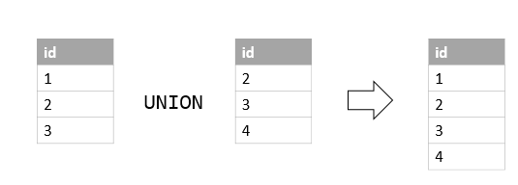
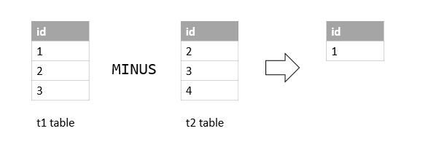
UNION and MINUS
What if I want to access data that is in two tables together in one?

Slide 29

BREAK!

Slide 30
Revision(PRIMARY KEY)
A field that uniquely identifies a record in the table.
ID | Name | Last Name | email
1 | Walder | Frey | walder19@gmail.com
2 | Walder | Frey | wfrey@gmail.com
3 | Walder | Frey | walderfrey@gmail.com
4 | Walder | Frey | wfrey91@gmail.com

Slide 31
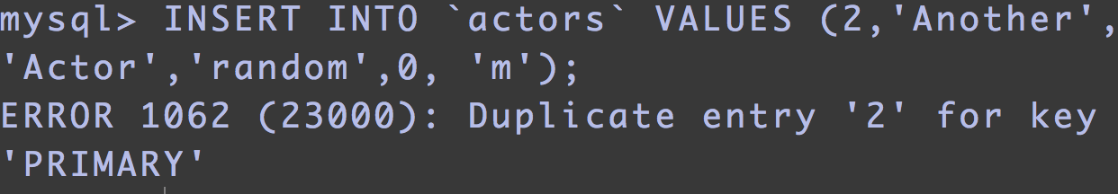
Revision(PRIMARY KEY)
show create table actors;
CREATE TABLE actors (
aid int(11),
fname varchar(50),
lname varchar(50),
biography text,
age tinyint(2),
gender varchar(1),
PRIMARY KEY (aid)
)
CREATE TABLE actors (
aid int(11) PRIMARY KEY,
fname varchar(50),
lname varchar(50),
biography text,
age tinyint(2),
gender varchar(1)
)
OR
If you try to insert a new record (actor) with an id value that is already in the db you will get an error:

Slide 32
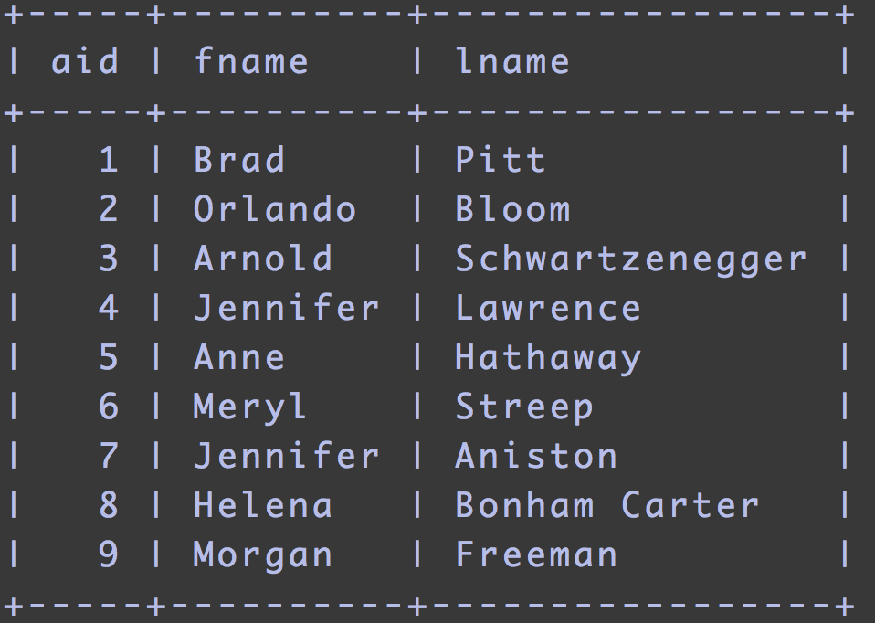
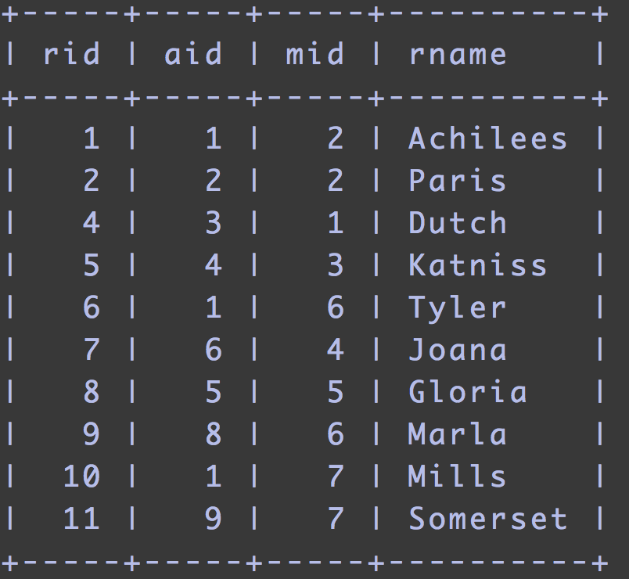
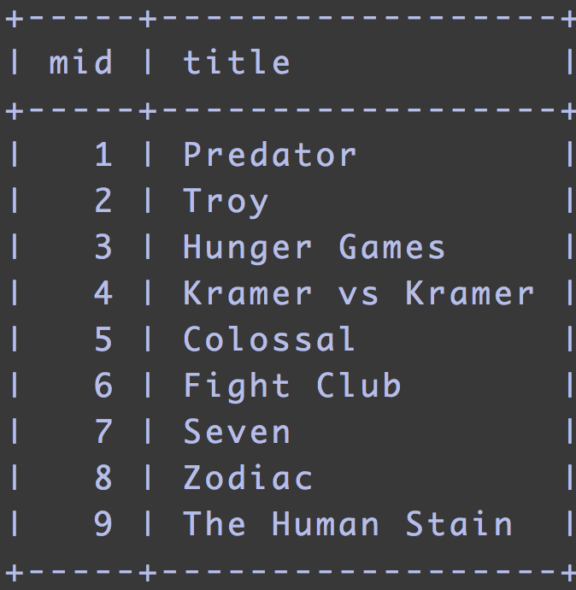
FOREIGN KEY
When you refer the primary key column of a table in another table then it becomes a FOREIGN KEY. It is a column that uniquely identifies rows in another table.
PK
PK
FK
FK
PK
Actors table
Roles table
Films table
Notes:
Used to link/ establish a relationship tables. It is common for a table to have 2 or more foreign keys. For example the roles table has 2 foreign keys. A foreign key points to the primary key of another table.

Slide 33
See FOREIGN KEY definition
show create table roles;
CREATE TABLE roles (
aid int(11) NOT NULL,
mid int(11) NOT NULL,
rname varchar(50) DEFAULT NULL,
rid int(11) NOT NULL,
PRIMARY KEY (rid),
KEY mid (mid),
KEY aid (aid),
CONSTRAINT roles_ibfk_1 FOREIGN KEY (mid) REFERENCES films (mid),
CONSTRAINT roles_ibfk_2 FOREIGN KEY (aid) REFERENCES actors (aid)
) |

Slide 34
FOREIGN KEY Constraints
Before you can insert a role for an actor (foreign key), you need to insert the actor in the actors table (primary key):
You cannot add a role for an actor if the actor does not exist:
TRY: INSERT INTO roles (aid, mid, rname, rid) VALUES (32, 2,'John',42);
You cannot remove an actor if he still has active roles:
TRY: DELETE FROM actors WHERE aid = 1;
You cannot delete the table actors while you have a foreign key constraint:
TRY: DROP TABLE actors;

Slide 35
Aliases
Help us make the queries shorter and more readable. Defined with the keyword AS:
SELECT actors.fname, roles.rname FROM actors, roles WHERE actors.aid =roles.aid;
SELECT a.fname, r.rname FROM actors AS a, roles AS r WHERE a.aid =r.aid;

Slide 36

JOIN - Time to start navigating!

Slide 37
Why are we using JOINS?
Database is structured in (simple) tables to avoid:
data duplication (storage)
repeated columns (think about changing business rules)
update anomalies (multiple updates instead of single row update)
delete anomaly (loss of “reference” data when last occurence is deleted)
Think about (logical) data model and normalisation.
Tables contain columns (PRIMARY KEY <-- FOREIGN KEY).
JOINS are used to combine tables using “related” columns.

Slide 38

JOIN -
mysql> SELECT code, name, region FROM country WHERE code = 'USA';
+-------+-------------------+--------------------+
| Code | name | region |
+-------+-------------------+--------------------+
| USA | United States | North America |
+-------+-------------------+--------------------+
1 row in set (0.00 sec)
mysql> SELECT * FROM city WHERE countryCode = 'USA' LIMIT 1;
+------+--------------+--------------------+-------------+---------------+
| ID | Name | CountryCode | District | Population |
+------+--------------+--------------------+-------------+---------------+
| 3793 | New York | USA | New York | 8008278 |
+------+--------------+--------------------+-------------+---------------+
1 row in set (0.22 sec)
Notes:
What do you see here?

Slide 39
Typical uses for a JOIN
Join a reference table (get the actor’s name based on his actor’s id)
Get 1:M relationships
get the children from parents (like a city is a child of a country)
Get the transaction history:
get all orders from a customer
get the list of products and their quantity in an order
get the product price (start date, end date)
get all invoice items from an invoice
get the list of payments for a customer
get unpaid invoices (left outer join with payments)
Reporting
Star diagram (customer name, customer segment, product name, product category, region)

Slide 40
JOINS
Get all the countries where English is the official language.
With a WHERE statement:
SELECT Name FROM country, countrylanguage WHERE Countrycode = Code AND Language = 'English';
This corresponds to an INNER JOIN.

Slide 41

JOIN

Slide 42
INNER JOIN
Get all the countries where English is the official language.
With an INNER JOIN statement:
SELECT Name FROM country INNER JOIN countrylanguage ON Countrycode = Code WHERE Language = 'English';
SELECT Name FROM country INNER JOIN countrylanguage ON Countrycode = Code AND Language = 'English';
You can omit the word INNER.

Slide 43
OUTER JOIN
Get all countries which does not have an (official) language.
SELECT Name FROM country LEFT OUTER JOIN countrylanguage ON Countrycode = Code WHERE CountryCode IS NULL;
An outer join is typically used when there is no data available.
Otherwise an inner join would not provide results.
Depending on the order of the tables you use LEFT of RIGHT join.
You can omit the word OUTER.

Slide 44
subSELECT = single value SELECT between ( )
Find the actors who have played 2 roles:
SELECT fname, lname FROM actors WHERE aid = (SELECT aid FROM roles GROUP BY aid HAVING COUNT(*) = 2);
SELECT fname, lname FROM actors AS a JOIN roles AS r ON a.aid = r.aid GROUP BY r.aid HAVING COUNT(*) = 2;
SELECT fname, lname, rname, title FROM actors AS a JOIN roles AS r ON a.aid = r.aid JOIN films AS f ON f.mid = r.mid WHERE r.aid = (SELECT aid FROM roles GROUP BY aid HAVING COUNT(*) = 2);
Notes:
Instead of JOIN you can use subSELECT.
A subselect is a value you obtain via another SELECT statement.

Slide 45
Many to many relationship M:M
How would you implement: M:M relationships are split in 2 x 1:M relationships.
Person --< TeamMembership >-- Team
Give the details of possible attributes, primary keys, foreign keys
What date columns would you add?
… think about describing the history ...
What constraints? (dates!)
What other tables could you add? (skills, roles, training, projects, application, systems, server, buildings, location)
Very much used in real world applications.

Slide 46
Data quality
JOIN is normally performed between PRIMARY KEY and FOREIGN KEY
Pay attention not to create false data when joining (e.g. forget one AND clause)
Pay attention to priority NOT AND OR -> use ( ) when necessary
Find the actors and their roles for all the male actors or the actors with age above 50: ( ) required
SELECT fname, lname, rname FROM actors, roles WHERE actors.aid = roles.aid AND ( gender = 'm' OR age > 50 );
select * from city where population >= 1000000 and district = 'England';
select * from city where not population < 1000000 and district = 'England';

Slide 47
DELETE rows
To remove data rows from a table:
DELETE FROM table WHERE … ;
Reasons:
Remove old data
Delete wrong data
Privacy reasons
e.g. when a customer does not order during 1 year we cannot contact him anymore for marketing purposes
We must still keep his invoicing and payment data for 10 years
Ordering details can be deleted after e.g. 5 years
When an employee does not work for the company any more we need to delete his national number
We need to keep the pay slip for 10 years
See GDPR (European Data protection rules - new EU privacy law as of 2018)

Slide 48
Data privacy rules
Clear obsolete data
UPDATE employee SET national_number = NULL WHERE employee_id = 1003;
UPDATE employee SET national_number = NULL WHERE employee_revoke_dt < date - 365;

Slide 49
ALTER TABLE
ALTER TABLE can be used to change the structure of a table.
Add a column
Drop a column
Increase the size of a string column
Change the data type of a column
Add or drop keys (primary, foreign, lookup)

Slide 50
ALTER TABLE - Add a column
Imagine you have a table alterex containing orders.
The customer would like to have a delayed order. So you need a delivery date.
ALTER TABLE alterex ADD deliveryDt DATE;
DESC alterex;
+------------+---------+------+-----+---------+-------+
| Field | Type | Null | Key | Default | Extra |
+------------+---------+------+-----+---------+-------+
| ordernum | char(9) | YES | | NULL | |
| deliveryDt | date | YES | | NULL | |
+------------+---------+------+-----+---------+-------+

Slide 51
ALTER TABLE - Drop a column
Dropping a column means that you also delete the data.
ALTER TABLE alterex DROP deliveryDt;
DESC alterex;
+------------+---------+------+-----+---------+-------+
| Field | Type | Null | Key | Default | Extra |
+------------+---------+------+-----+---------+-------+
| ordernum | char(9) | YES | | NULL | |
+------------+---------+------+-----+---------+-------+

Slide 52
ALTER TABLE - Modify data type
Modifying the data type of a column from one type to another - or just altering the allowed size.
ALTER TABLE alterex MODIFY ordernum INT(9);
DESC alterex;
+----------+--------+------+-----+---------+-------+
| Field | Type | Null | Key | Default | Extra |
+----------+--------+------+-----+---------+-------+
| ordernum | int(9) | YES | | NULL | |
+----------+--------+------+-----+---------+-------+

Slide 53
ALTER TABLE - Add/Drop Primary Key
ALTER TABLE alterex ADD [CONSTRAINT PK_name]
PRIMARY KEY (ordernum);
DESC alterex;
+----------+---------+------+-----+---------+-------+
| Field | Type | Null | Key | Default | Extra |
+----------+---------+------+-----+---------+-------+
| ordernum | char(9) | NO | PRI | NULL | |
+----------+---------+------+-----+---------+-------+
ALTER TABLE alterex DROP PRIMARY KEY;

Slide 54
ALTER TABLE - Add/Drop FOREIGN Key
CREATE table otherex(id INT(3) PRIMARy KEY);
ALTER TABLE alterex ADD other INT(3);
ALTER TABLE alterex ADD CONSTRAINT FK_name FOREIGN KEY (other) REFERENCES otherex(id);
+----------+---------+------+-----+---------+-------+
| Field | Type | Null | Key | Default | Extra |
+----------+---------+------+-----+---------+-------+
| ordernum | char(9) | NO | PRI | NULL | |
| other | int(3) | YES | MUL | NULL | |
+----------+---------+------+-----+---------+-------+
ALTER TABLE alterex DROP FOREIGN KEY fk_name;
Notes:
Maybe the key was forgotten
The data model has changed
A new functionality requires an additional index

Slide 55
Homework 1 (More Queries)
*In case of an error you can always source the sql file again
WORLD:
What is the name and the population of the most populated city in India?
List the names of the countries having at least 3 cities with 3 million inhabitants.
What is the number of all the official languages? List the country name and their official languages.
Find all the countries that have only one official language
Find which countries do not have a capital.
Which country has the lowest population?
Make a list with all the languages spoken in Eastern Africa.
IMDB
Find the minimum and the maximum age of the actors per gender.
Find how many actors are in their 20’s, 30’s, 40’s, 50’s etc (grouped by decade).
Add a column to the films table for storing the duration (runtime) or each film.
Alter the data type of column age to INT.
Print the names and biographies of the actors in this format “ANNE HATHAWAY BIO: 1 golden globe”
Delete the column biography from films.
Notes:
SELECT name, population FROM city WHERE population = (select MAX(population) FROM city WHERE countrycode = "IND");
SELECT c.Name, COUNT(*) AS cityCount FROM country AS c INNER JOIN city AS t ON Countrycode = Code WHERE t.Population >= 1000000 GROUP BY Code HAVING cityCount >= 10;
select count(*) as count, floor(age/10)*10 as d from actors group by d;
SELECT gender, MIN(age) AS min_age, MAX(age) As max_age FROM actors group by gender;

Slide 56
Homework 2
Modify your ERD after what you saw today.
Create the a database, create the relevant tables and populate them with trips, customers, payments and a few more (at least 10 in each table).
Use Primary and Foreign Keys to link the tables.
Create the queries (using JOINS) to tell us:
How many trips did a customer book.
What are the destinations of your favourite package?
Which are the packages that include Paris?
Or any other queries that you can think of (be creative!)

Slide 57
Homework 3 (optional)
Create a new ERD based on the imdb database.
Include more entities like: Directors, Oscars etc
Pay attention to Cardinality & Modality
Be creative :)

